Slide 1
CGB1221-DATABASE MANAGEMENT SYSTEMS
Department of Artificial Intelligence and Data Science
Academic Year: 2024 – 2025
Register Number : 2303811724321095
Name : SAKTHI VISHAL C
Year : II
Semester : IV
Section : B
Date : 04.06.2025

Slide 2
Title of the Project
DIGI LOCKER APP

Slide 3
Problem Identification
Users often struggle to securely store and manage personal identity documents.
Aadhar card, Voter ID, and education documents are frequently required but not always readily accessible.
Existing digital storage methods may lack proper authentication and security.
No centralized system exists for authenticated users to upload and manage these documents easily and securely.

Slide 4
Objective
Upload and store Aadhar card images and details
Save Voter ID card information
Maintain education-related documents and details
Ensure strong user authentication for data protectionEnhance document security, availability, and integrity in digital form

Slide 5
Proposed Architecture

Slide 6
List of Modules
User Module
Document Module
Folder Module
Sharing Module
Security Module

Slide 7
Module Description
User Module
Handles user registration, login, and authentication.
Ensures only verified users can access the system.
Manages user profile and session data.

Slide 8
Module Description
Document Module
Allows users to upload, view, edit, and delete documents.
Supports Aadhar card images, Voter ID details, and education documents.
Maintains metadata (upload date, document type, etc.).

Slide 9
Module Description
Folder Module
Organizes user documents into categorized folders.
Allows users to create, rename, or delete folders.
Helps in easy navigation and document management.

Slide 10
Module Implementation
Sharing Module
Enables users to share documents securely with others.
Provides share options with permission controls (view/download only).
Tracks shared document status and history.

Slide 11
Module Description
Security Module
Ensures encryption of stored documents and data.
Implements secure authentication (e.g., OTP, password hashing).
Prevents unauthorized access and data breaches.

Slide 12
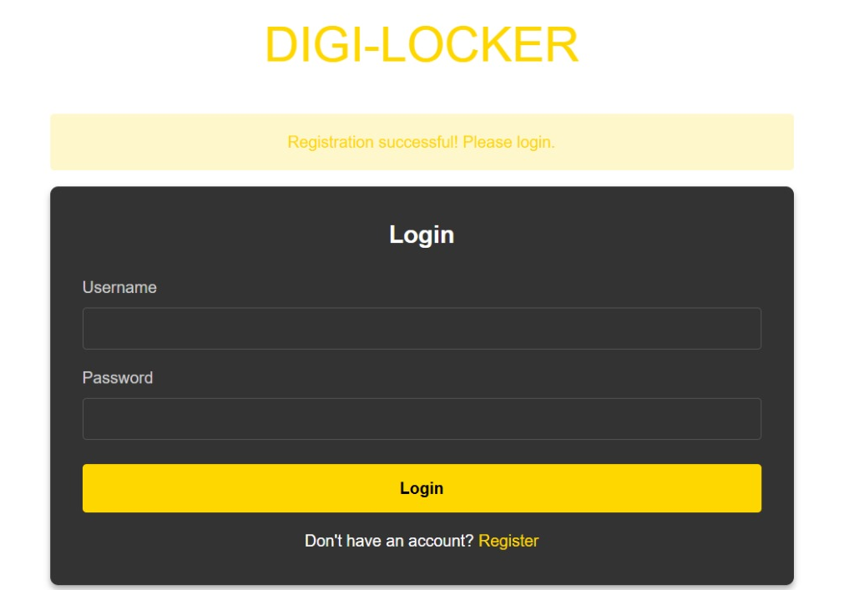
Module Implementation

Slide 13
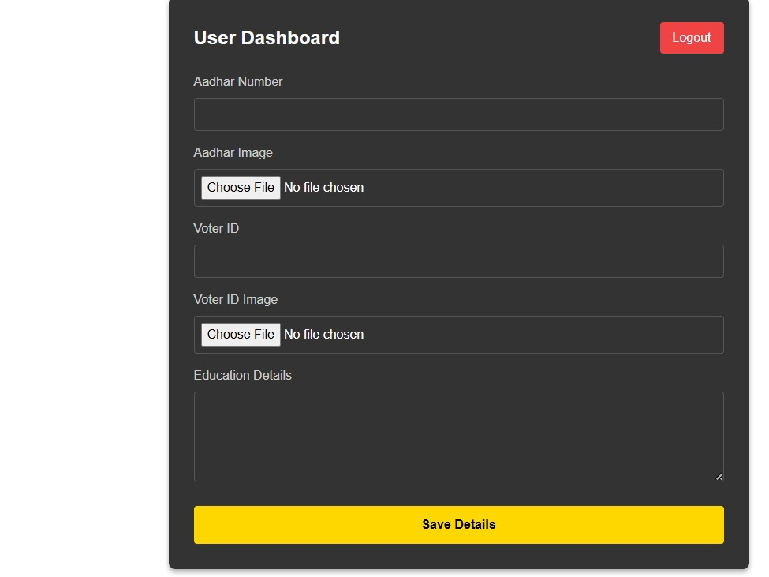
Module Implementation

Slide 14
Results

Slide 15
Conclusion
Conclusion:
Developed a secure DigiLocker system using DBMS concepts.
Successfully implemented document storage, organization, and sharing.
Access logs add an extra security layer.
System is scalable and user-friendly.
Demonstrated the effectiveness of relational DBMS in managing digital documents.

Slide 16
Thank You

